Slide 1
The Land of Fire & Ice
Joseph Walker
February 9, 2017

Slide 2
Why Iceland?
Super Cheap Flights on…
Not a major tourist destination… yet.
Waterfalls! So many waterfalls.

Slide 3
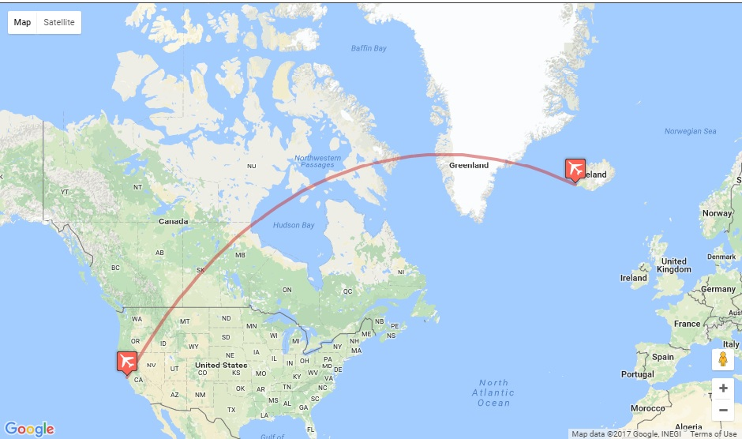

KEF
4198 miles
9 hours
SFO

Slide 4
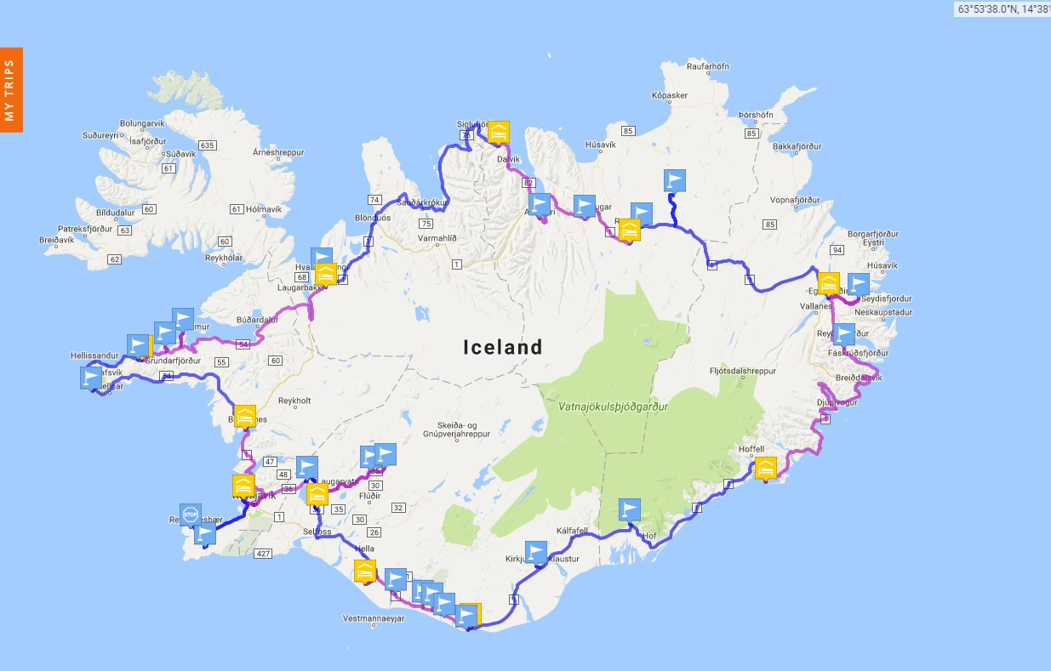
Road Trip via Route 1
Trip Stats
Trip Duration: 12 Days
Counter-Clockwise Route
Mileage: ~ 1385 miles
Driving Duration: 31 hours
Avg. Temp: 32F

Slide 5
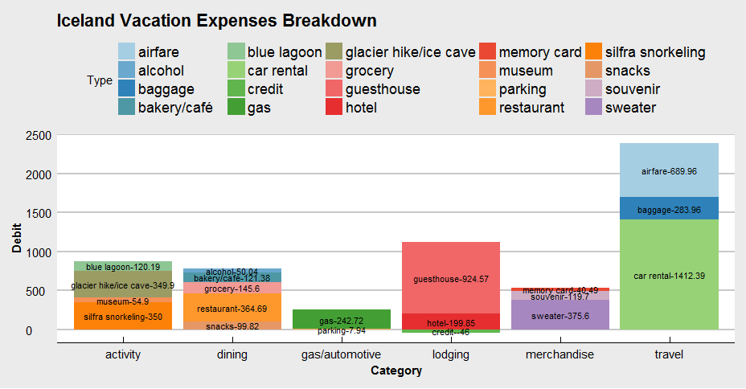
Grand Total: $5907

Slide 6
South West & The Golden Circle

Slide 7
East Iceland

Slide 8
Northern Iceland

Slide 9
Western Iceland

